Slide 1
Bathroom Renovation
Project presentation

Slide 2
Introduction
The foremost objective is to make over an archaic master bathroom a more spacious and appealing one.
Dimensions were accurately taken to make sure the products apt into place as planned.
Modifications for gaining storage space and improved lighting were prioritized to make sure that the refurbished bathroom stands the test of time.

Slide 3
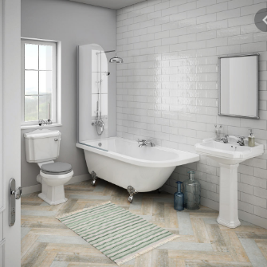
Bathroom Photo

Slide 4
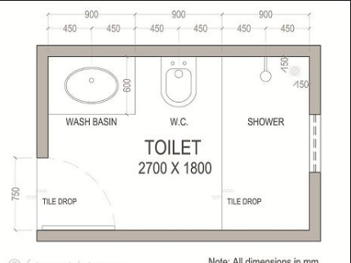
Electronic Design (before) Dimensions in MM
Floor dimensions: 2700mm by 1800 mm
Shower area dimensions: 900mm by 700mm
Products selected
Wash basin 900mm by 600mm
Water closet 700mm by 320mm

Slide 5
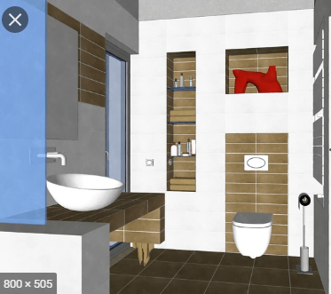
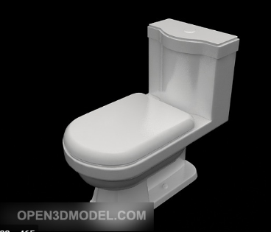
Digital model (existing bathroom)

Slide 6
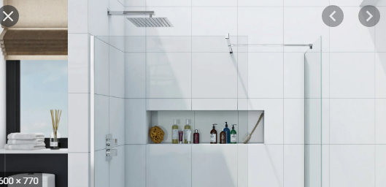
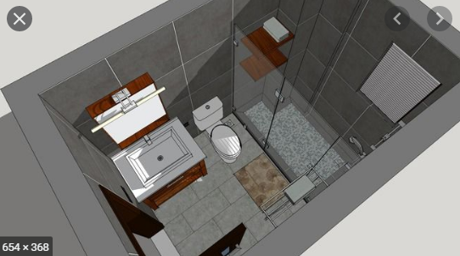
Digital model (existing bathroom)

Slide 7
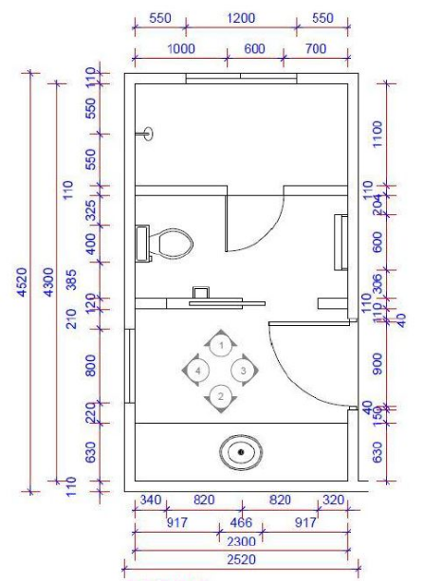
Electronic design( proposed Model)
Drawn to scale of 1:10
The fixtures in this bathroom facelift were changed to separate the shower from the toilet.
Bathroom backsplashes were fitted to prevent water from ruining the walls as well as giving it a new look.
Tall cabinet with dimensions 1500 by 600 by 400 mm was installed which increased storage space.
A sink was installed near the exit door.
Bath was repositioned to make use of the available space.
Wash basin was removed to create more space.
Window repositioned and creation of an extra window to allow more light to enter the bathroom.

Slide 8
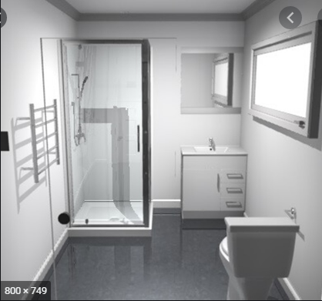
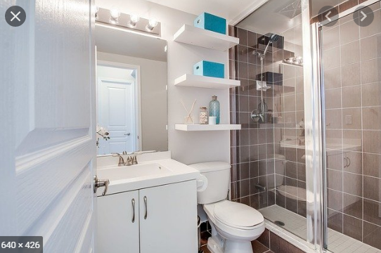
Digital model(proposed bathroom)
Proposed model

Slide 9
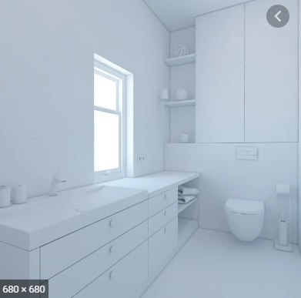
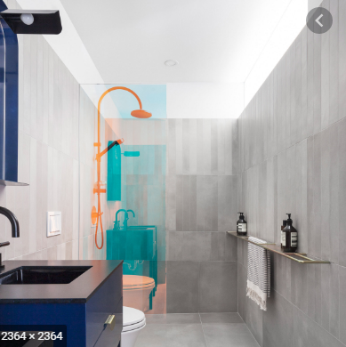
Proposed model

Slide 10
calculations
The surface area of the floor= ((2300 x 1100) + (2300 x 1110) + (2300 x 1860)) x 100
= 936100000mm2
= 9.361m2
Window 1 area= (1200 x 110) x 100
= 13200000mm2
= 0.132m2
Window 2 area= (600x 110) x 100
=6600000mm2
=0.066m2

Slide 11
Calculations
Backsplash tiles around the walls excluding shower area: tiles lifted at a height of 150cm. SA of the back splash tile is same as the surface area of the floor which is 9.361m2
Shower area floor = (2300 x 1100) x100= 253000000mm2
=2.53m2

Slide 12
Conclusion
The renovated bathroom with the backsplash tiles and the removal of unnecessary walls gave it a new look. The repositioning of the windows and bath allowed for better performance in terms of lighting and spaciousness for storage.

